Slide 1




MBC 638: Data Analysis & Decision Making
Anna Chernobai
Lecture 13:
Hypothesis testing for population mean (Chapter 9)

Slide 2
Today: Hypothesis testing
Hypothesis testing for μ (population mean)

Slide 3

Hypothesis testing for μ
Goal: Use information from an observed sample (sample mean) to make inference about a population parameter (μ).
Population
Main idea:
We observe a specific sample of data and observe the value of x.
Based on this observation, we have a hypothesis about the population μ.
We would like to determine whether our hypothesis is supported by our data or not.
μ = ?
Observed Sample
x

Slide 4
Hypothesis testing for μ
A parallel between hypothesis testing and confidence intervals:
Similarity:
We observe sample mean. We wish to estimate population mean that is unknown.
Difference:
Confidence intervals: The goal is to find the interval within which μ falls.
Hypothesis testing: The goal is to know whether a hypothesis about μ is supported or not.

Slide 5
Hypothesis testing for μ
Example
A car dealer calculated that the company must average more than 4.8% profit on the sales of its new cars to cover its expenses. A random sample of 80 cars produced an average profit of 4.9% per car. The historical standard deviation is known to be 0.3%.

Slide 6
Hypothesis testing for μ
Example
A car dealer calculated that the company must average more than 4.8% profit on the sales of its new cars to cover its expenses. A random sample of 80 cars produced an average profit of 4.9% per car. The historical standard deviation is known to be 0.3%.
4.8%
average profit per car
GOAL

Slide 7

Hypothesis testing for μ
Example
A car dealer calculated that the company must average more than 4.8% profit on the sales of its new cars to cover its expenses. A random sample of 80 cars produced an average profit of 4.9% per car. The historical standard deviation is known to be 0.3%.
4.8%
average profit per car
GOAL
Sample:
n = 80
Xbar = 4.9
Sigma = 0.3

Slide 8
Hypothesis testing for μ
Example
A car dealer calculated that the company must average more than 4.8% profit on the sales of its new cars to cover its expenses. A random sample of 80 cars produced an average profit of 4.9% per car. The historical standard deviation is known to be 0.3%.
4.8%
average profit per car
GOAL
Sample:
n = 80
Xbar = 4.9
Sigma = 0.3
We observe: xbar > target mu

Slide 9
Hypothesis testing for μ
Example
A car dealer calculated that the company must average more than 4.8% profit on the sales of its new cars to cover its expenses. A random sample of 80 cars produced an average profit of 4.9% per car. The historical standard deviation is known to be 0.3%.
4.8%
average profit per car
Formulate hypothesis: Based on the observed sample mean, does the data provide sufficient evidence to indicate that the sales policy is achieving a true mean profit exceeding 4.8% per car?
GOAL
Sample:
n = 80
Xbar = 4.9
Sigma = 0.3
We observe: xbar > target mu

Slide 10
Hypothesis testing for μ
Example
A car dealer calculated that the company must average more than 4.8% profit on the sales of its new cars to cover its expenses. A random sample of 80 cars produced an average profit of 4.9% per car. The historical standard deviation is known to be 0.3%.
Based on the observed mean, does the data provide sufficient evidence to indicate that the sales policy is achieving a true mean profit exceeding 4.8% per car?
The hypothesis: Research hypothesis: µ > 4.8

Slide 11
Hypothesis testing for μ
Example
A car dealer calculated that the company must average more than 4.8% profit on the sales of its new cars to cover its expenses. A random sample of 80 cars produced an average profit of 4.9% per car. The historical standard deviation is known to be 0.3%.
Based on the observed mean, does the data provide sufficient evidence to indicate that the sales policy is achieving a true mean profit exceeding 4.8% per car?
The hypothesis: Research hypothesis: µ > 4.8
The main idea behind the testing procedure: If x=4.9 is an outlier (unusually large) relative to 4.8, then our hypothesis is supported and indeed true µ is > 4.8. If not, then our hypothesis is not supported.

Slide 12
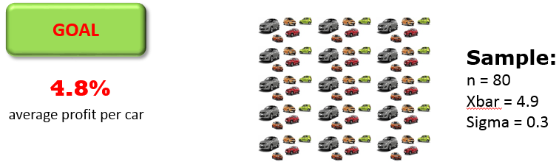
Statistical Procedure:
Step 1: Summarize the hypotheses:
hypothesis: µ > 4.8
Research hypothesis

Slide 13
Statistical Procedure:
Step 1: Summarize the hypotheses:
Null hypothesis: H₀: µ ≤ 4.8
Alternative hypothesis:* H_{A}: µ > 4.8
Research hypothesis
*The alternative hypothesis (H_{A} ) always summarizes what you want to test.

Slide 14
Statistical Procedure:
Step 1: Summarize the hypotheses:
Null hypothesis: H₀: µ ≤ 4.8
Alternative hypothesis:* H_{A}: µ > 4.8
Research hypothesis
*The alternative hypothesis (H_{A} ) always summarizes what you want to test.
In a sense, you are always testing 2 hypotheses in parallel, but only one of them will be supported.

Slide 15
Statistical Procedure:
Step 2: Calculate the test statistic:

Slide 16
Statistical Procedure:
Step 2: Calculate the test statistic:
0
z

Slide 17
Statistical Procedure:
Step 3: Calculate the p-value:
p-value
z
test statistic

Slide 18
Statistical Procedure:
Step 3: Calculate the p-value:
0.0014
z

Slide 19
Statistical Procedure:
Step 3: Calculate the p-value:
0.0014
Therefore, with μ₀=4.8, x=4.9 is an outlier.
z

Slide 20
Hypothesis testing for μ
Statistical Procedure:
Step 4: Compare p-value with α and state your conclusions.
α = the maximum error you are willing to accept (is given).
p-value = the “actual error from the sample” = the measure of evidence against the
null hypothesis H₀. Smaller p-values indicate more evidence against H₀ .
Decision rule: Reject H₀ if p-value < α

Slide 21
Example: summary
A car dealer calculated that the company must average more than 4.8% profit on the sales of its new cars to cover its expenses. A random sample of 80 cars produced an average profit of 4.9% per car. The historical standard deviation is known to be 0.3%.
Based on the observed sample mean, does the data provide sufficient evidence to indicate that the sales policy is achieving a true mean profit exceeding 4.8% per car? Use α=1%.
Step 1: H₀: µ ≤ 4.8
H_{A}: µ > 4.8
Step 2: Compute test statistic:
Step 3: Compute p-value:
Step 4: Compare p-value=0.0014 with α=0.01. P-value < α. Reject H₀. We have sufficient evidence to conclude that the company is indeed achieving policy of over 4.8% average profit per car.

Slide 22
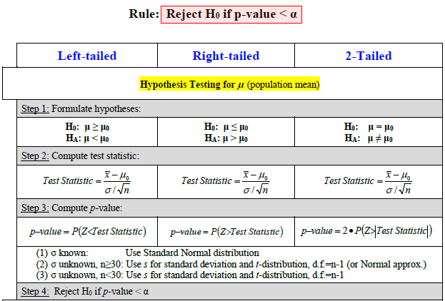
Hypothesis testing for μ

Slide 23
Hypothesis testing for μ
Case 1: σ is known
Use Standard Normal.
Case 2: σ is unknown, n≥30
Same as “case 1”, but use s instead of σ. Use t distribution (can also use Standard Normal to approximate).
Case 3: σ is unknown, n<30
Use s instead of σ, and use t distribution, d.f. =n-1.

Slide 24
Hypothesis testing for μ
Example
Annual per capita consumption of milk is 21.6 gallons (Statistical Abstract of the United States 2006). A sample of 76 individuals from the coastal town of Santa Barbara showed an average annual consumption of 24.1 gallons with a standard deviation of 4.8. Based on this observation, you believe milk consumption is higher on the west coast and would like to test this hypothesis.
Using α=0.05, determine whether this sample provides enough evidence to conclude that the average annual consumption of milk in Santa Barbara is higher than the national average.
Using α=0.05, determine whether this sample provides enough evidence to conclude that the average annual consumption of milk in Santa Barbara is different from the national average.
Construct a 95% confidence interval for the average annual consumption of milk in Santa Barbara. Can you see how this interval reinforces your conclusion in part b)?

Slide 25
Hypothesis testing for μ
Example
Annual per capita consumption of milk is 21.6 gallons (Statistical Abstract of the United States 2006). A sample of 16 individuals from the coastal town of Santa Barbara showed an average annual consumption of 24.1 gallons with a standard deviation of 4.8. Based on this observation, you believe milk consumption is higher on the west coast and would like to test this hypothesis.
Using α=0.05, determine whether this sample provides enough evidence to conclude that the average annual consumption of milk in Santa Barbara is higher than the national average.
Using α=0.05, determine whether this sample provides enough evidence to conclude that the average annual consumption of milk in Santa Barbara is different from the national average.
Construct a 95% confidence interval for the average annual consumption of milk in Santa Barbara. Can you see how this interval reinforces your conclusion in part b)?

Slide 26

Today: Hypothesis testing
Hypothesis testing for μ (population mean)

